Slide 1
Opinion Mining on English and Urdu
News Articles
Guide : Prof. Parag Singla
Co-Guide : Prof. Maya Ramanath
Ruturaj Mohanty

Slide 2
Problem Statement
This project endeavours to develop a web based software to
help analyze opinions on news articles centered around Indian media in general and Kashmir related articles to be specific.
Contents:-
Challenges
Labelling Guidelines
Previous Approach (MTP-I)
Current Approach (MTP-II)
Results & User Interface
Future Work

Slide 3
Challenges
News articles are not bounded to any specific domain
Biasness towards negative sentiment
Kashmir specific articles have a lot of words and phrases related to army, warfare, militants, killings, terrorists, border issues etc.
The word ”opinion” here is itself ambiguous.
5. Capturing individuals sentiment or opinion is difficult as individuals judgement is based on preconceived knowledge, experiences, societal thoughts, personal views, perception etc.
6. Breaking the news article into meaningful chunks at test time

Slide 4
Labelling Ground Rules
1. We are concerned about the author's point of view. Personal views and opinions should be avoided.
Example Sentence/Chunk - The Indian govt. should frame this policy of hanging people who rape minor girls, Label - Positive
2. Generalized facts or statements can be labelled independent of author's view.
Example Sentence/Chunk - Terrorism is a curse to the society, Label - Neutral
3. Don't label if unsure or don't have much idea about the issue or context.
Example Sentence/Chunk - Students of morning/evening Darasgahs and other educational institutions run by Karwan-e-Islami would participate in ‘Naat-o-Qruat’.

Slide 5
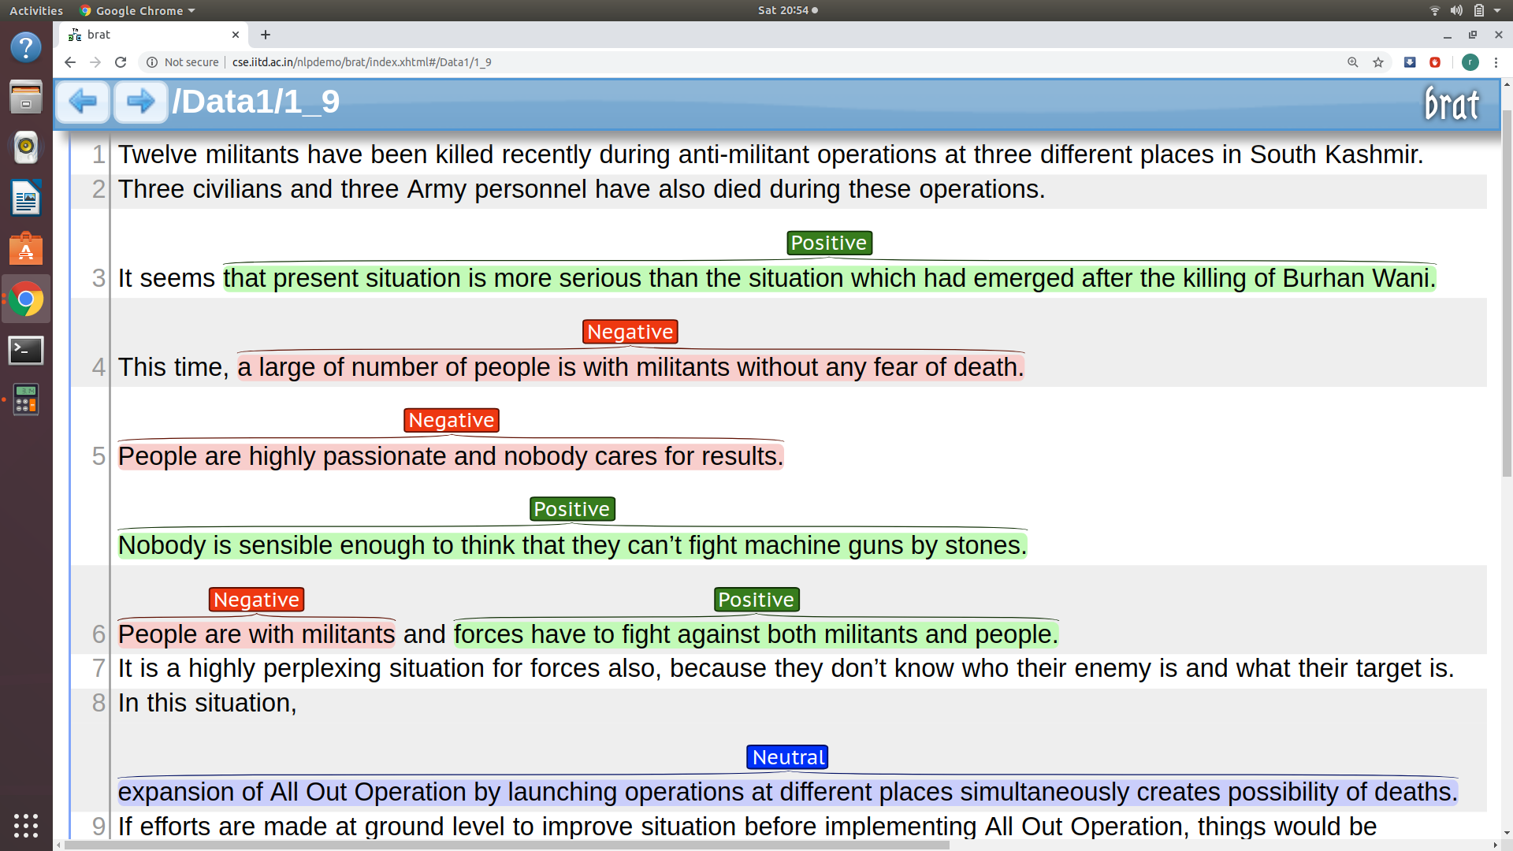

Slide 6
Baseline Model
Model - SVM-NB
The SVM-NB first constructs an optimal separating hyperplane that divides samples in the training set into two categories. For samples located nearby the hyperplane, if they are in different categories, one of them will be eliminated from the training set. In this way, the dependence between samples is reduced and the entire training sample space is simplified. With the trimmed training set, the naive Bayes algorithm is applied to classify texts in the test set
Results :-
Number of Chunks - 7000
Split ratio - 8:1:1 (Train:Val:Test)
max_features - 1000
ngram_range - 2
10-fold Test Accuracy - 68.8

Slide 7
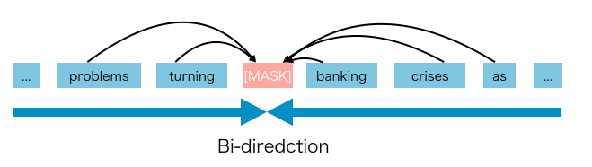
Previous Approach - Finetune BERT
What is BERT (Bidirectional Encoder Representations from Transformers) ?
‘Language models use either left context or right context, but language understanding is bidirectional.’

Slide 8
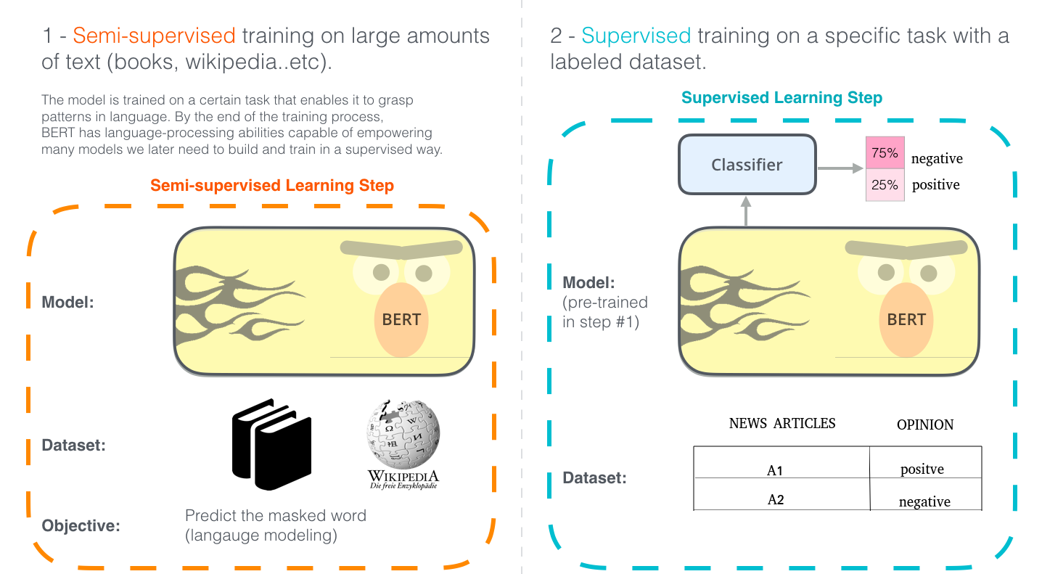

Slide 9
Results on 3 class classification
Labeled Dataset 1 (User 1):
Total samples: 7000
Split ratio - 8:1:1 (Train:Val:Test)
Model - Bert Base Uncased
Max Length: 512
Batch Size: 6
10-fold Testing Accuracy: 85.57%
Confusion Matrix:
ACTUAL
PREDICTED
 | pos | neu | neg
pos | 2441 | 474 | 85
neu | 216 | 1738 | 46
neg | 22 | 167 | 1811

Slide 10
Current Approach - Language Model + Classifier
Unsupervised Language Model Training
Language Model - mLSTM (multiplicative LSTM)
Combined architecture of mRNN and LSTM
Both controlled and flexible input-dependent transitions, to allow for fast changes to the distributed hidden representation without erasing information.
Supervised Classifier Training
Softmax Classifier
Xgboost
Neural Network
SVM

Slide 11
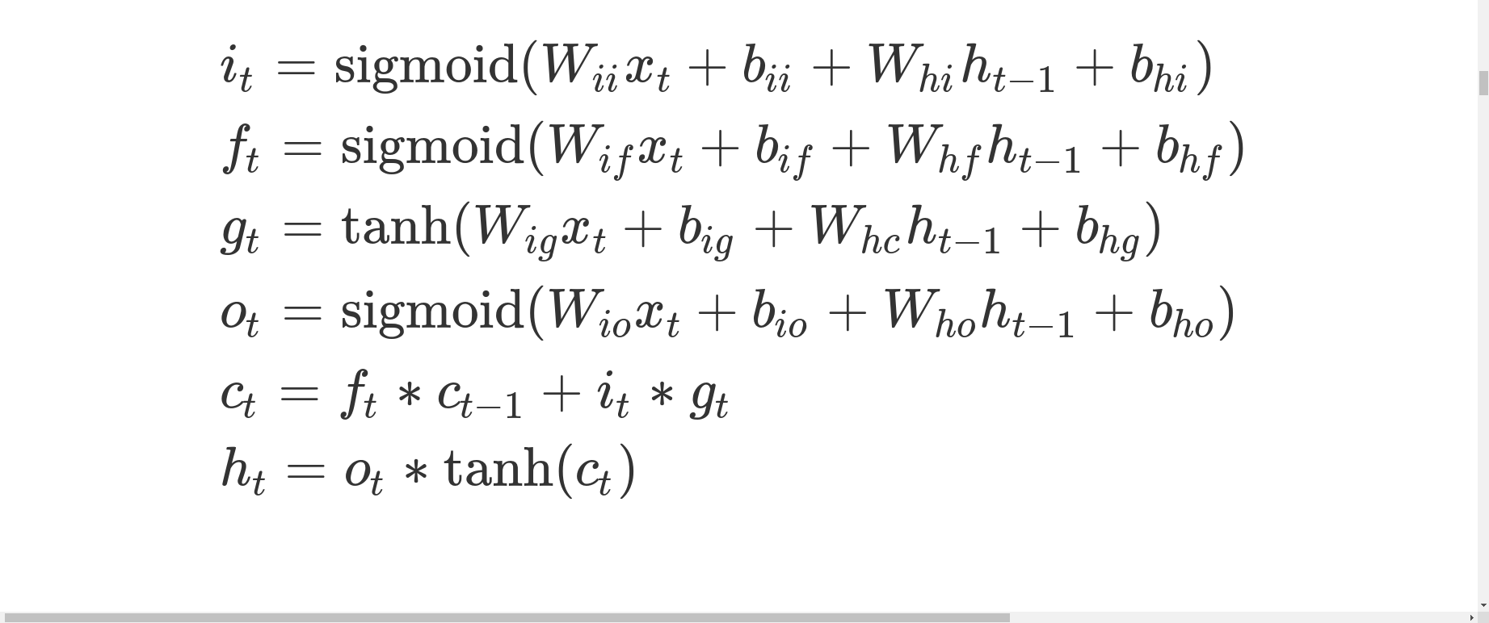
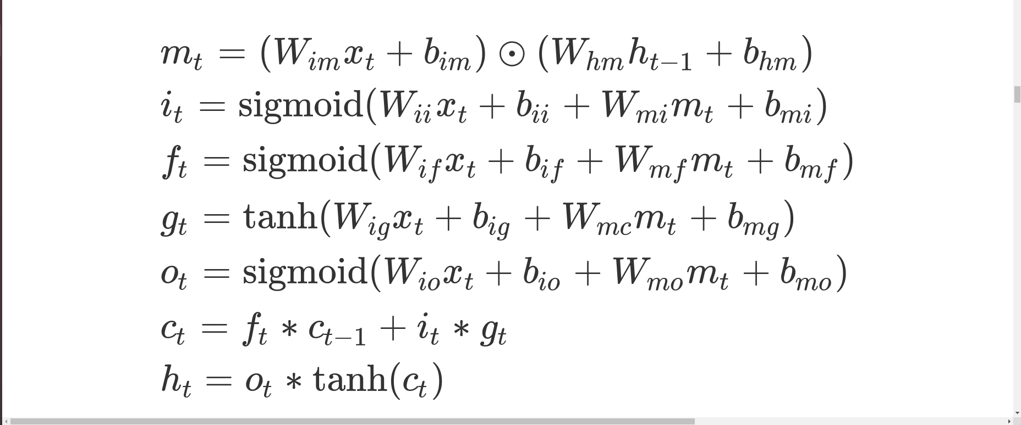
Why mLSTM ? (LSTM vs mLSTM)

Slide 12
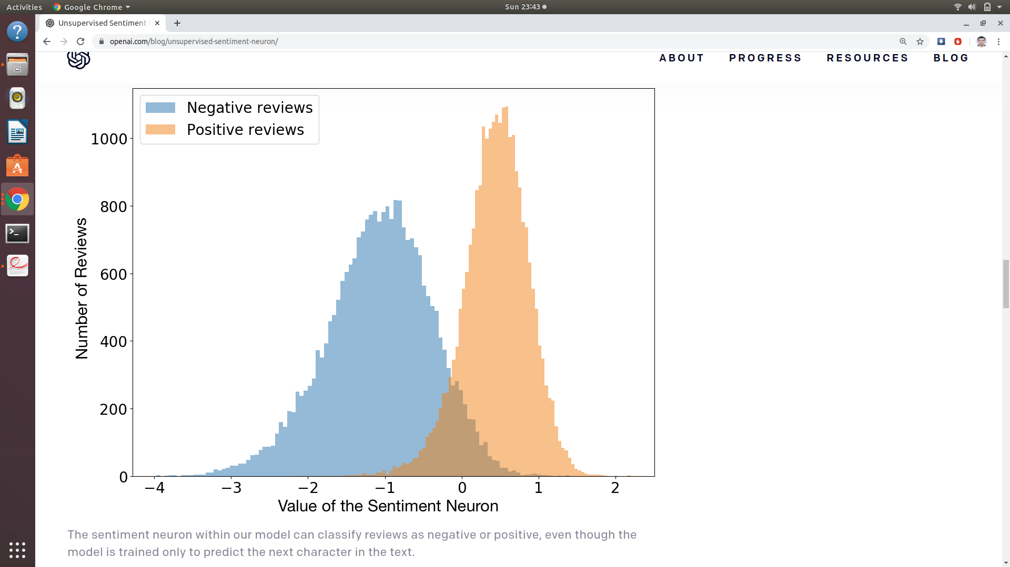
Why mLSTM ? (Open AI Paper & Their Claim)

Slide 13
mLSTM Training
- Training Data - 0.5 million Indian news articles
- Epochs Trained - 100
- Sequence Length - 256
- Vocab Size - 256
- Word Embedding Size - 64
- Batch Size - 128
- Trained on 1 V100 gpu on IITD HPC
- 32 GB of gpu memory
- 3 models were trained:-
One 4096 hidden units model
Two 2048 hidden units model with different parameter settings

Slide 14
mLSTM Training (Results)
MODEL | HIDDEN UNITS | BATCH SIZE | VOCAB SIZE | EMBEDDING SIZE | AVG BPC
1 | 2048 | 128 | 256 | 64 | 1.2101
2 | 2048 | 128 | 256 | 128 | 1.2099
3 | 4096 | 128 | 256 | 64 | 1.1527

Slide 15
Supervised Classifier Training
- Trained different classifiers like Softmax, SVM, xgboost, neural network on top our unsupervised language model
- Experimented with some pre-existing language models like BERT
- Used a train-val-test split ratio of 8:1:1 on our total number of labelled chunks, i.e. 7000
- 10-fold test accuracy is reported to capture more generalised accuracy.

Slide 16
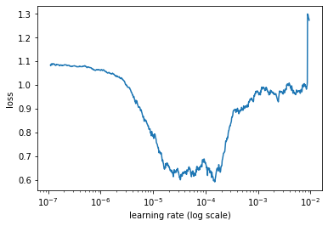
Supervised Classifier Training (Optimal Learning Rate)

Slide 17
Supervised Classifier Training (Results)
LANGUAGE MODEL | CLASSIFIER | TEST ACCURACY
- | SVM-NB | 68.8
Bert | Softmax | 85.57
mLSTM | Softmax | 90.52
mLSTM | XGBoost | 92.06
mLSTM | Neural Network | 85.20
mLSTM | SVM | 91.44

Slide 18
Test Time Chunking Algorithm Using Zero Shot Classifier
ALGORITHM OVERVIEW
Input the words ‘Positive’, ‘Negative’ & ‘Neutral’ into the language model and calculate the features
Input the chunk into the language model and calculate the features
Take similarity score of the two above obtained features
Using score check if the TONE changes and update accordingly

Slide 19
Test Time Chunking Algorithm Using Zero Shot Classifier
 | “State” | “State Govt.” | “State Govt. deserves” | “State Govt. deserves appreciation” | “State Govt. deserves appreciation but”
Positive | 0.18 | 0.20 | 0.32 | 0.94 | 0.31
Negative | 0.09 | 0.16 | 0.30 | 0.00 | 0.01
Neutral | 0.01 | 0.01 | 0.01 | 0.00 | 0.89

Slide 20
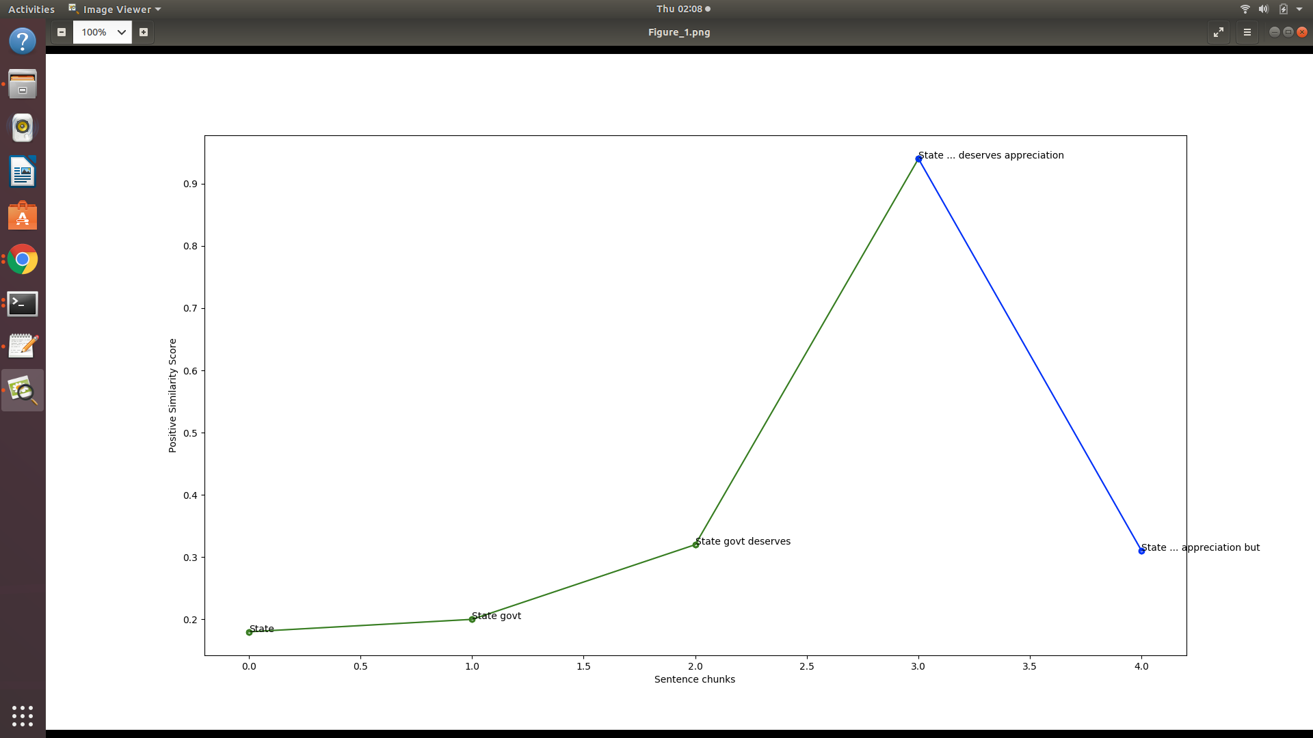
Test Time Chunking Algorithm Using Zero Shot Classifier

Slide 21
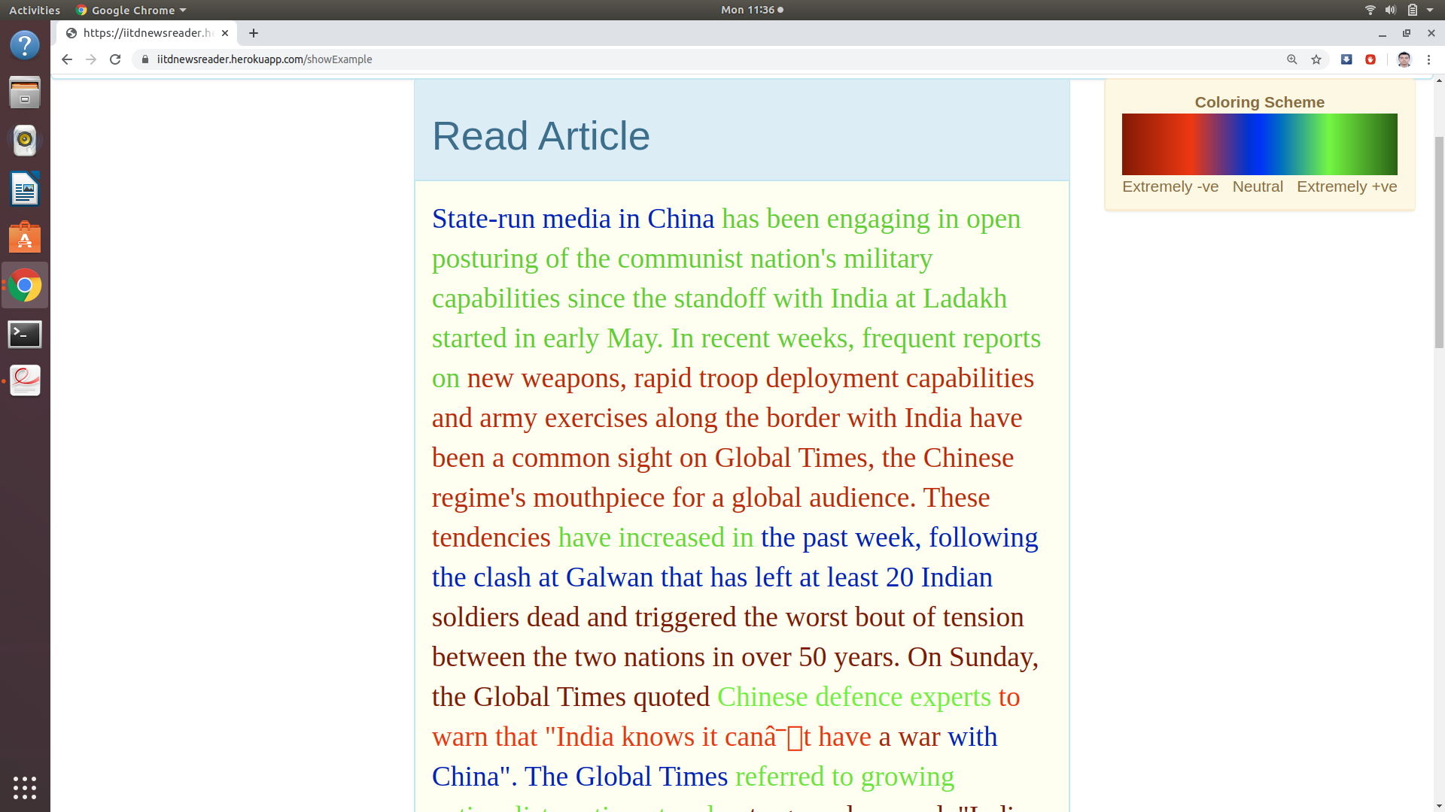
Results on English News Articles

Slide 22
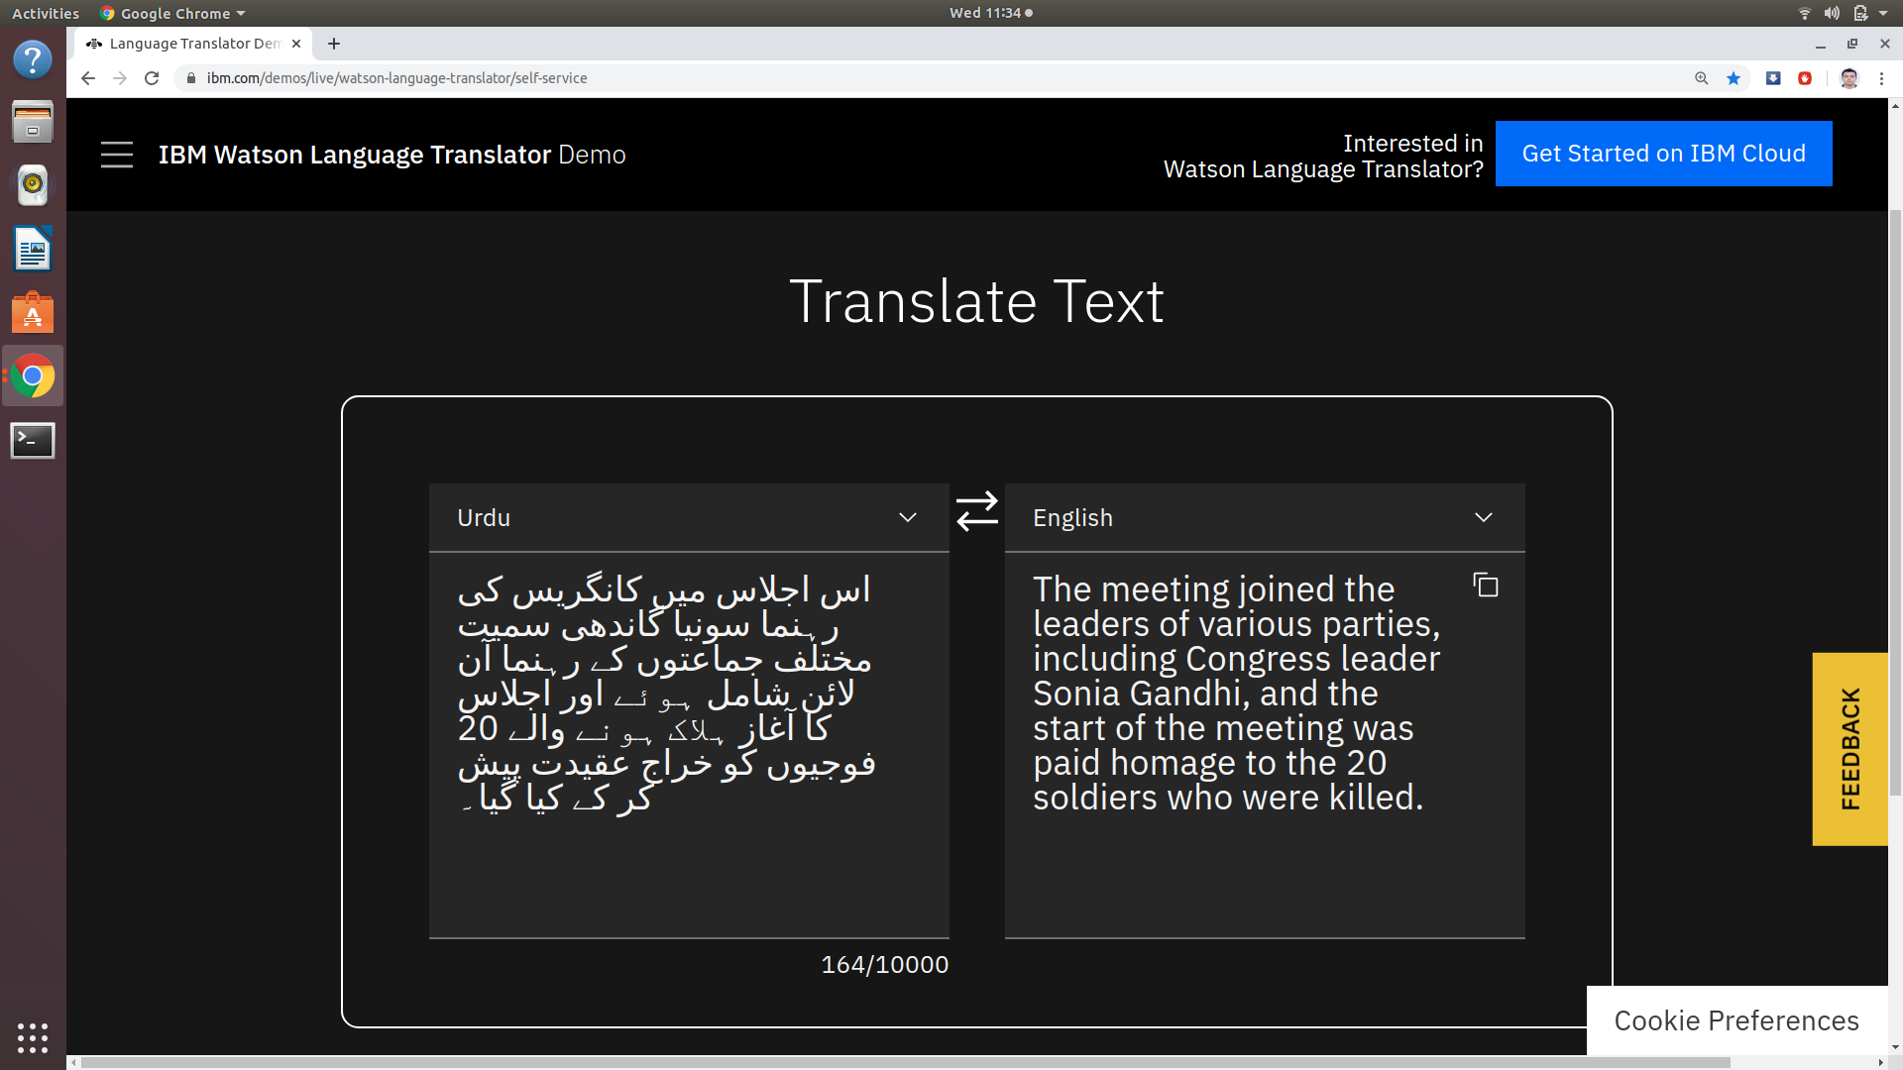
Urdu Translation (IBM watson)

Slide 23
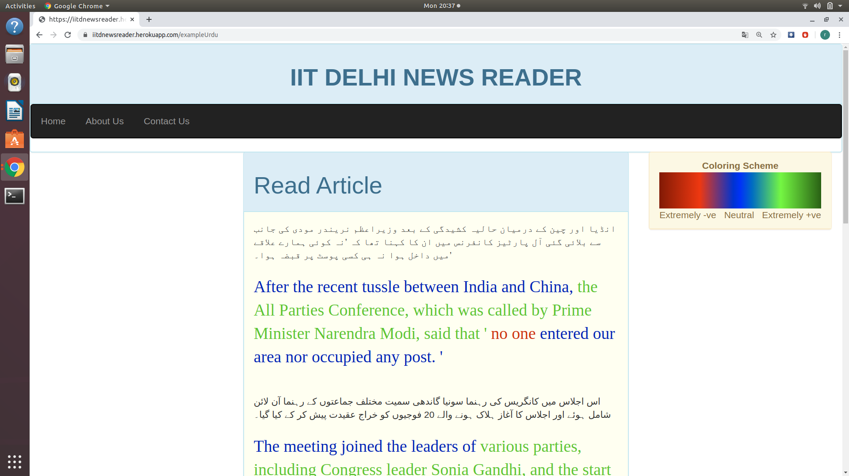
Results on Urdu News Articles

Slide 24
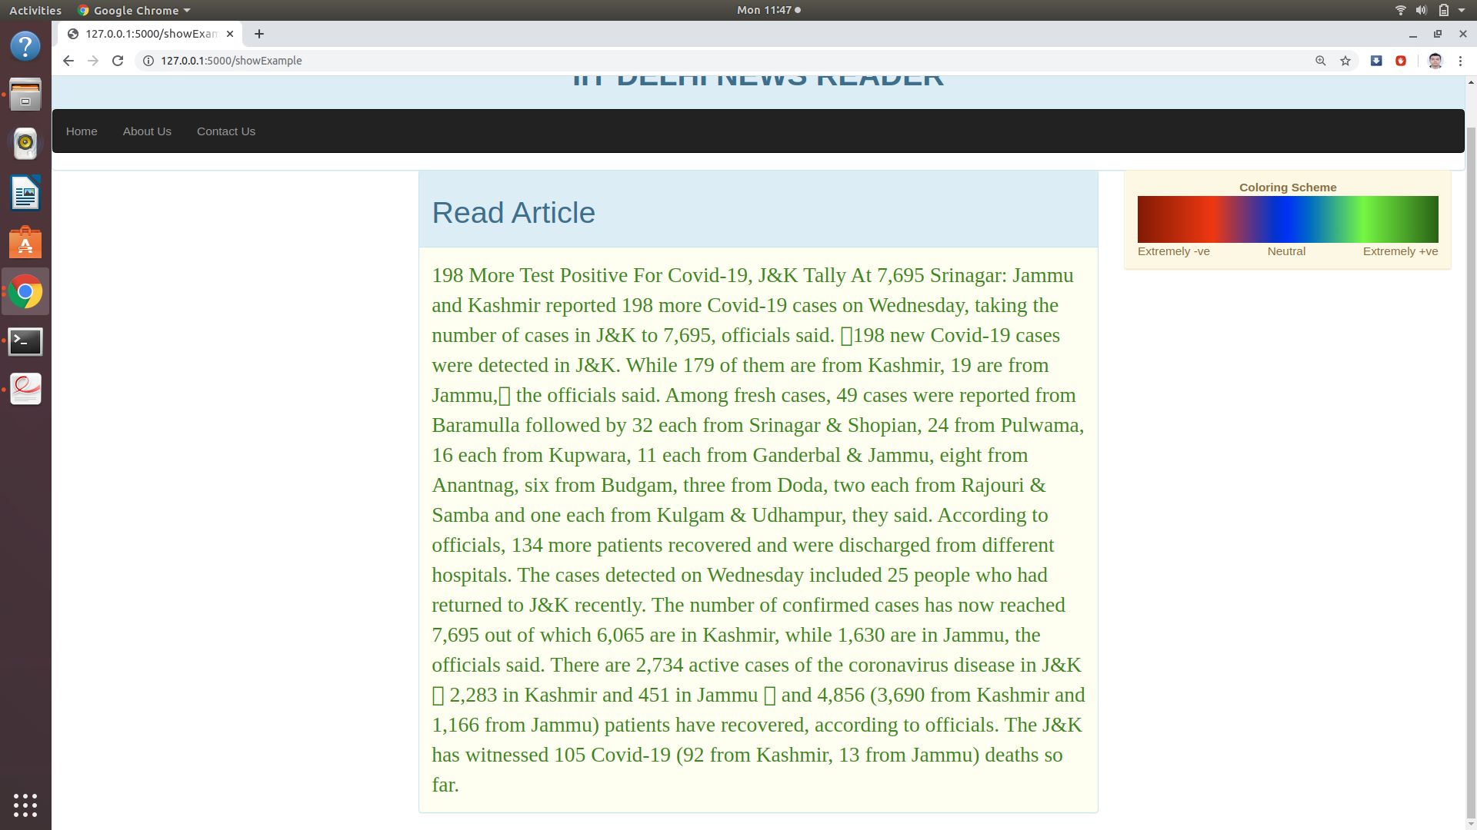
Case Study (Result on unknown new article)

Slide 25
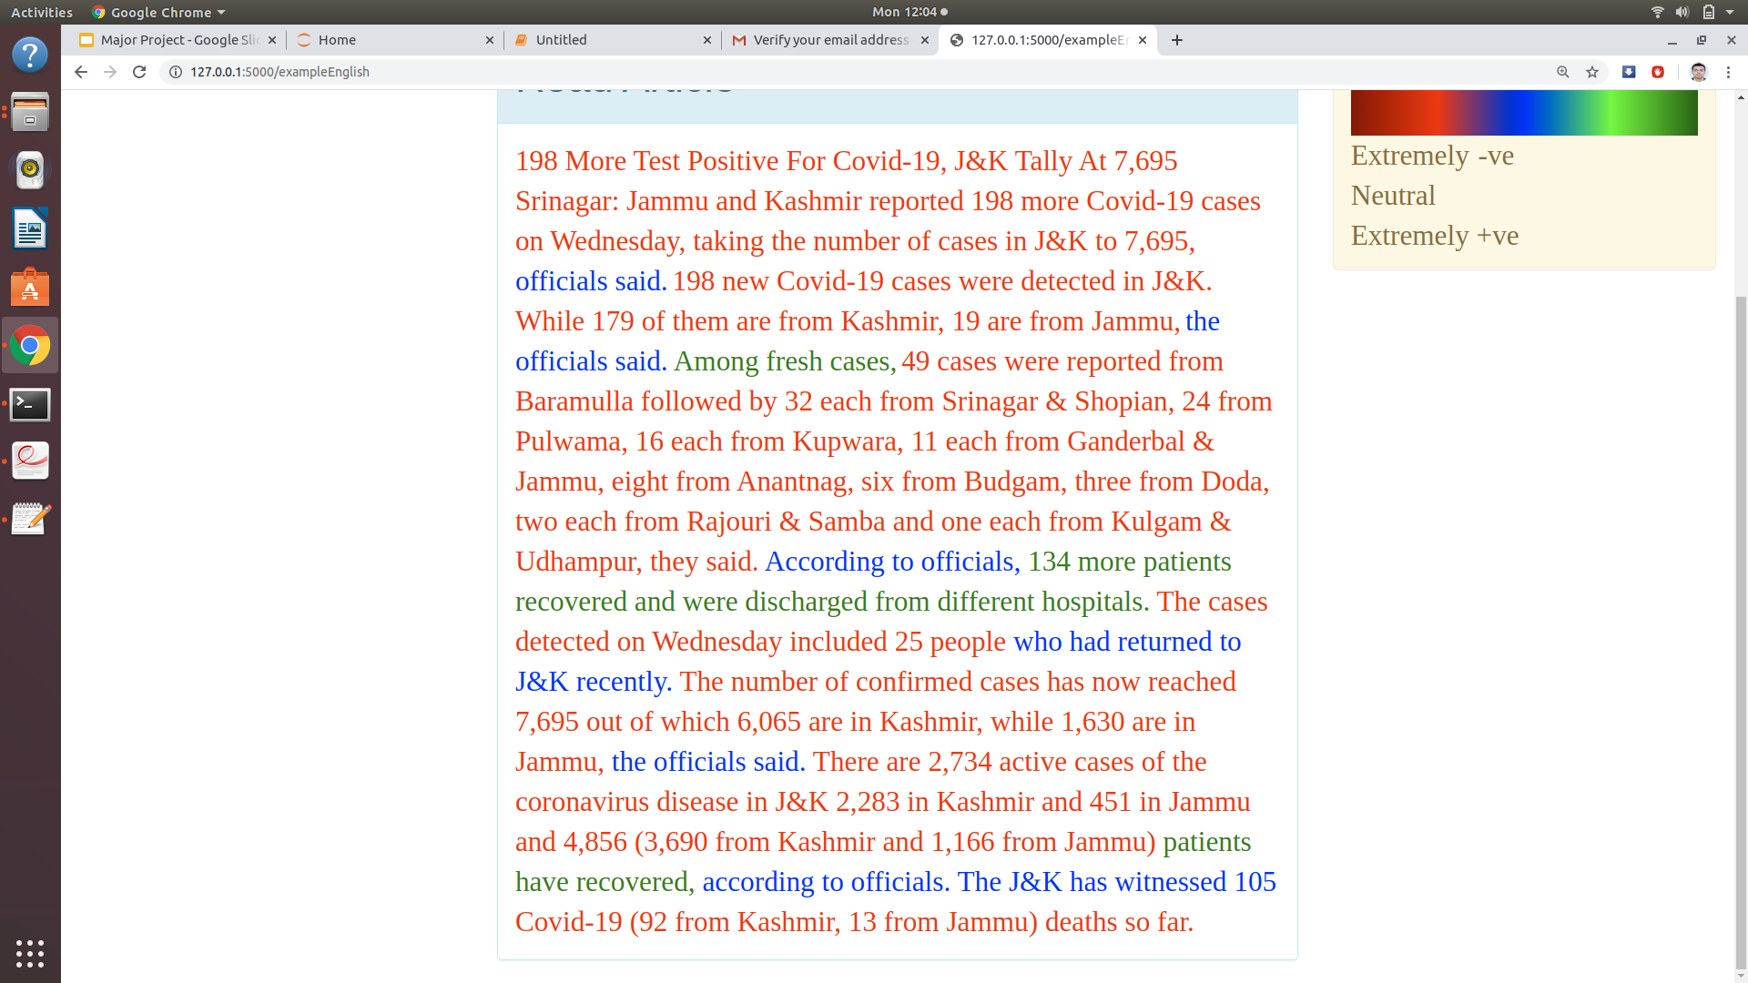
Case Study (Result on unknown new article)

Slide 26
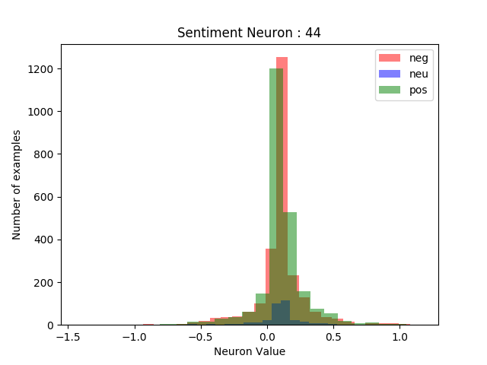
Results on Open AI Claim (Entire Dataset)

Slide 27
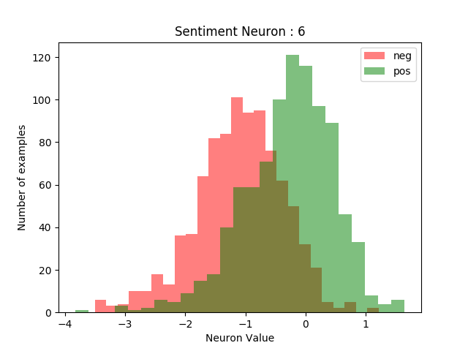
Results on Open AI Claim (Reduced Dataset)

Slide 28
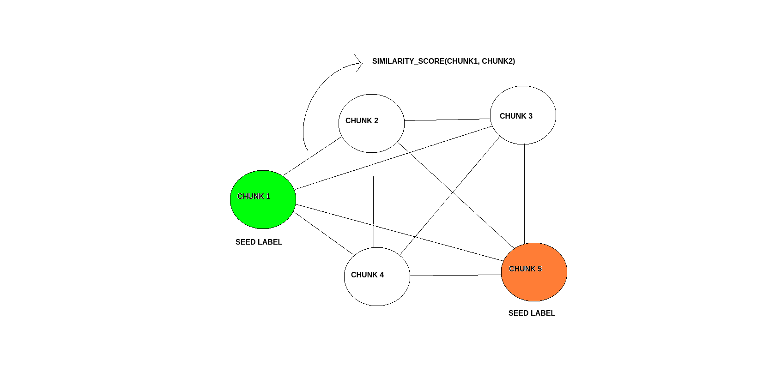
Additional Work ( Synthesizing more labelled chunks)
Artificially generating more labelled chunks using semi supervised technique

Slide 29
Future Work
The chunking algorithm can be further optimized
Word level or sentence level embedding can be tried on
The work can be extended to many other languages
Semi-supervised learning approach to generate more labelled chunks

Slide 30
References
https://github.com/google-research/bert
https://arxiv.org/abs/1810.04805
https://ai.googleblog.com/2018/11/open-sourcing-bert-state-of-art-pre.html
https://nlp.stanford.edu/seminar/details/jdevlin.pdf
https://static.googleusercontent.com/media/research.google.com/en//pubs/archive/43905.pdf
https://www.ibm.com/demos/live/watson-language-translator/self-service
https://arxiv.org/abs/1609.07959
https://talukdar.net/
https://translate.yandex.com/

Slide 31
Any Questions ???

Slide 32
Thank you !!!

